Slide 1
Cultural Guessing Game
Tsukuno JHS
3rd Grade

Slide 2
Quiz #1
Hint 1:
It is used to create art by folding paper.
Hint 2:
You can get square paper for this art.
Hint 3:
You can buy the paper at stationary store.
Hint 4:
A crane is a famous symbol of this art
Hint 5:
You can make cubes, animals, and household objects with this art.

Slide 3
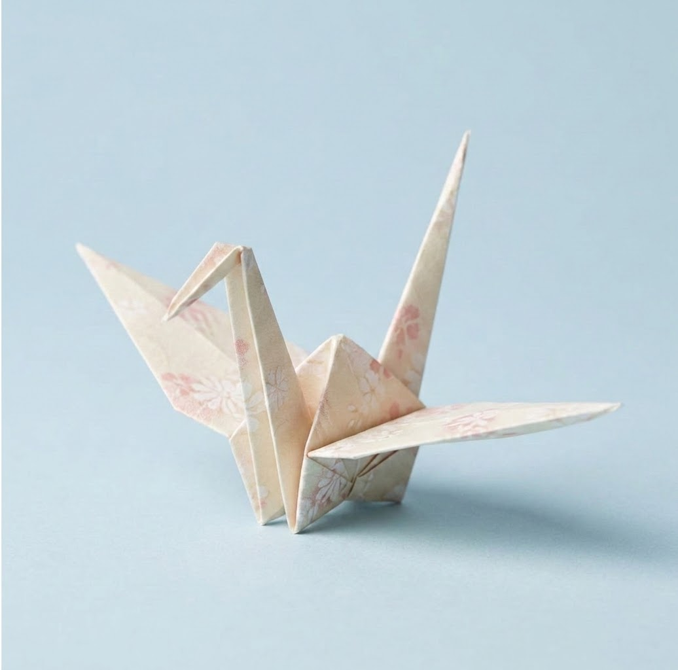
It is called…
origami

Slide 4
Quiz #2
Hint 1:
It is used when elementary students go to school
Hint 2:
You can buy at department store.
Hint 3:
You can get many different colors.
Hint 4:
It is very strong and expensive
Hint 5:
Children can carry heavy books inside of it.

Slide 5
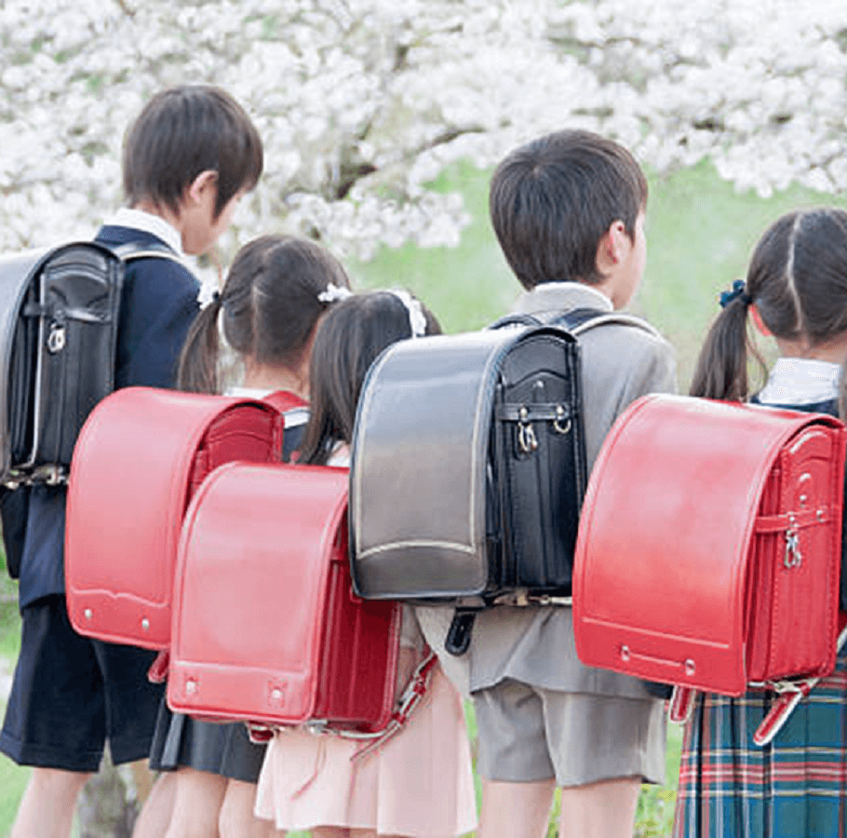
It is called…
randoseru

Slide 6
Quiz #3
Hint 1:
It is used when you want to wrap a gift or a bottle.
Hint 2:
You can get it at a souvenir shop.
Hint 3:
It is a square piece of cloth.
Hint 4:
It has many beautiful patterns.
Hint 5:
It is used to wrap a bento.

Slide 7
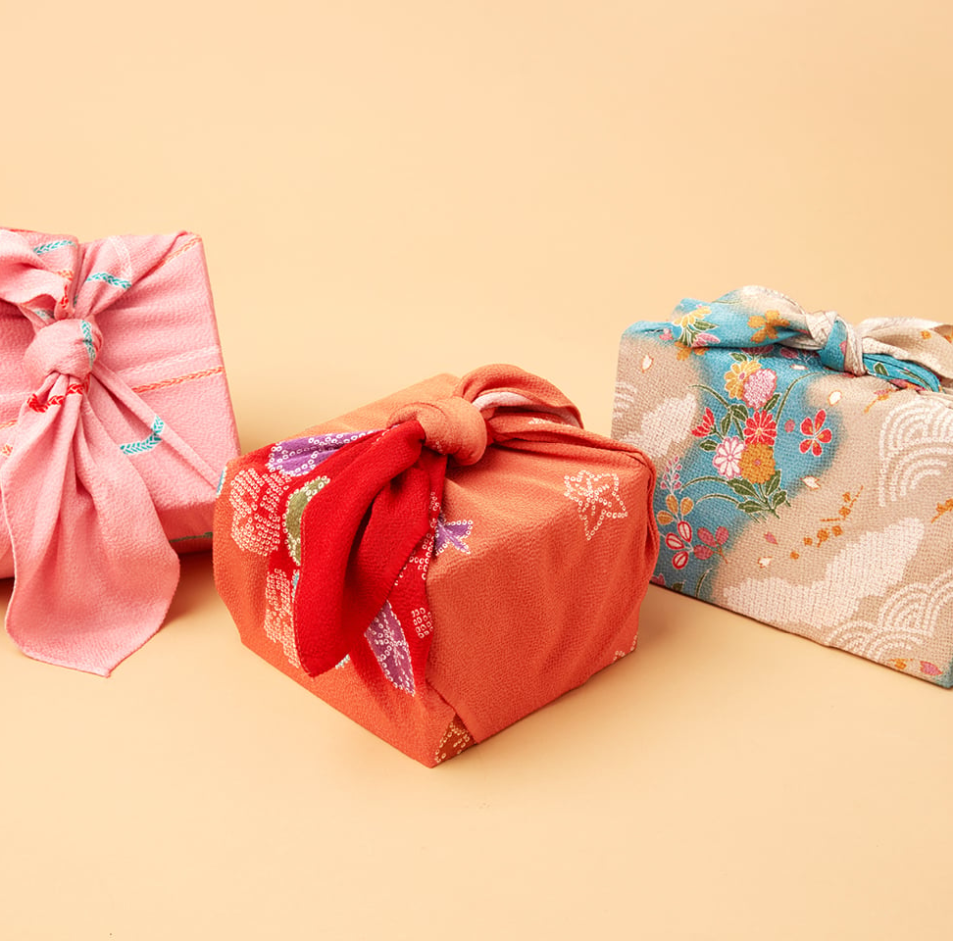
It is called…
furoshiki

Slide 8
Quiz #4
Hint 1:
It is used to bring good luck to a shop.
Hint 2:
You can get it at a temple.
Hint 3:
It looks like a cat.
Hint 4:
One hand moves “up and down”.
Hint 5:
You can see it near the door of many restaurants.

Slide 9
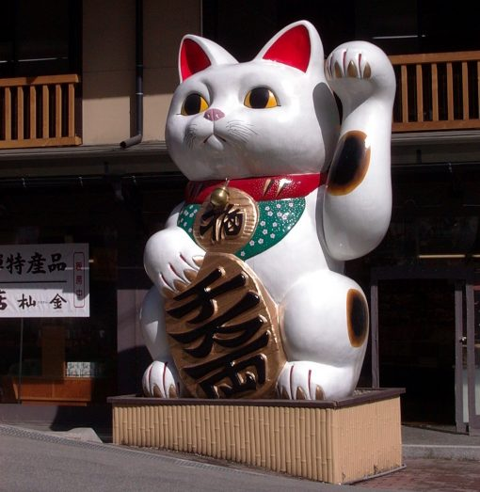
It is called…
maneki-neko

Slide 10
Quiz #5
Hint 1:
It is used to make a wish come true.
Hint 2:
You can buy it at a temple.
Hint 3:
It is usually small and round.
Hint 4:
It has no eyes when it is new.
Hint 5:
You paint the eyes when your wish comes true.

Slide 11
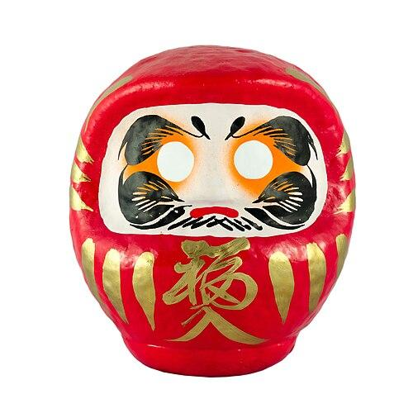
It is called…
daruma

Slide 12
Quiz #6
Hint 1:
It is used when you wear a kimono or yukata.
Hint 2:
You can buy it at a traditional shoe store.
Hint 3:
It is made of wood.
Hint 4:
It is very loud when you walk on the street.
Hint 5:
They are traditional japanese sandals.

Slide 13
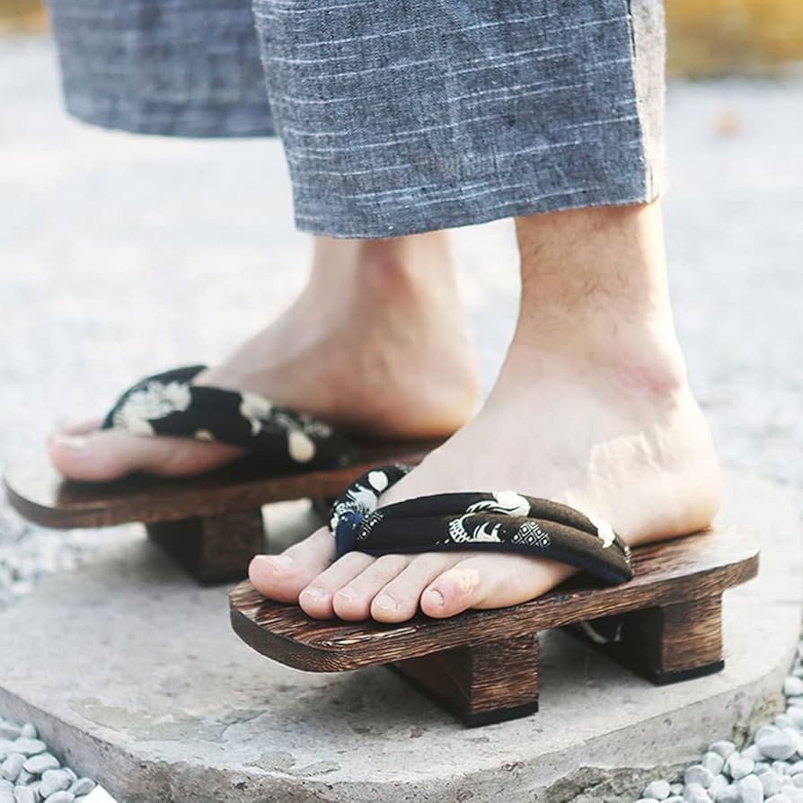
It is called…
geta

Slide 14
Quiz #7
Hint 1:
It is used when you want to protect your floors.
Hint 2:
You can buy it at a traditional home store.
Hint 3:
It is made from dried rush grass.
Hint 4:
It smells very unique, green, and fresh.
Hint 5:
You must take off your shoes to walk on it.

Slide 15
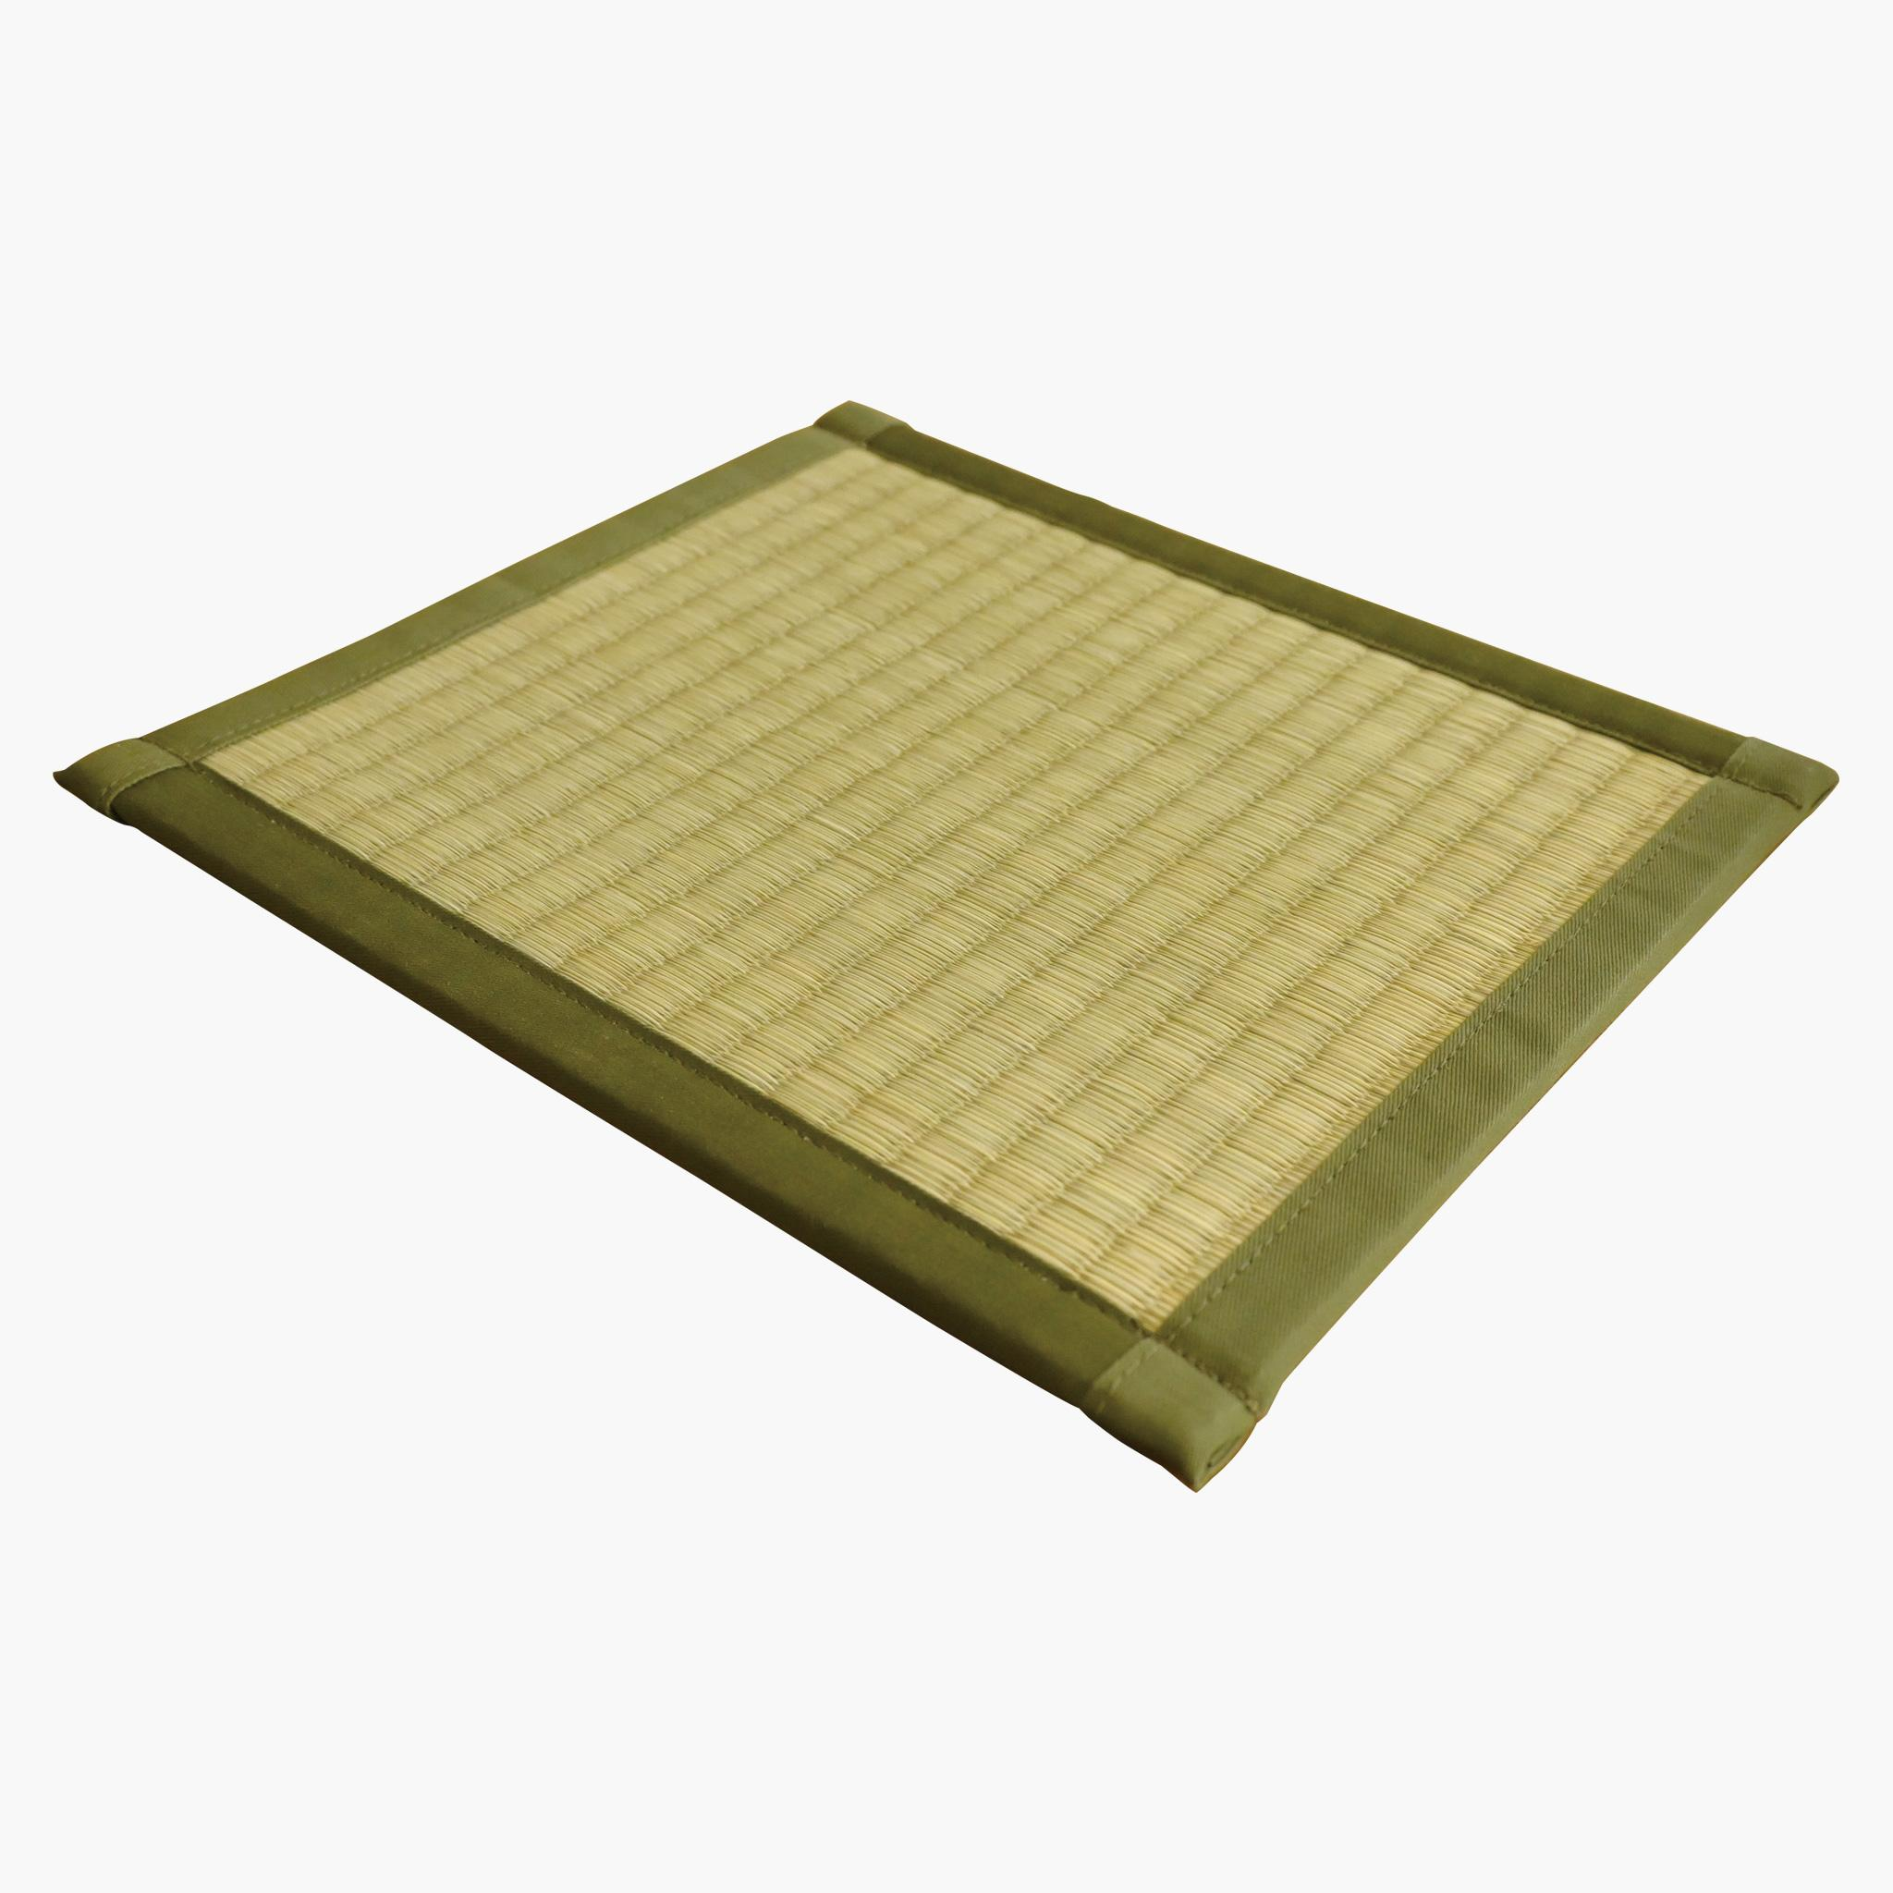
It is called…
tatami

